Slide 1

Essentials of Management Information Systems
Fourteenth Edition, Global Edition
Chapter 3
Achieving Competitive Advantage with Information Systems
Copyright © 2020 Pearson Education Ltd.
Notes:
If this PowerPoint presentation contains mathematical equations, you may need to check that your computer has the following installed:
1) MathType Plugin
2) Math Player (free versions available)
3) NVDA Reader (free versions available)

Slide 2
Porter’s Competitive Forces Model
Five competitive forces shape fate of firm
  Traditional competitors
  New market entrants
  Substitute products and services
  Customers
  Suppliers
Notes:
Porter's model is the best-known model of competitive advantage. The model provides a nice summary of the strategic situation of firms in a larger business environment. The model focuses on industry structure (or the environment of the firm) as the main determinant of management decisions about corporate strategies. Managers don't just make up strategies out of thin air. They look at the competitive situation in their industry, and then consider ways of coping and succeeding in that environment.

Slide 3
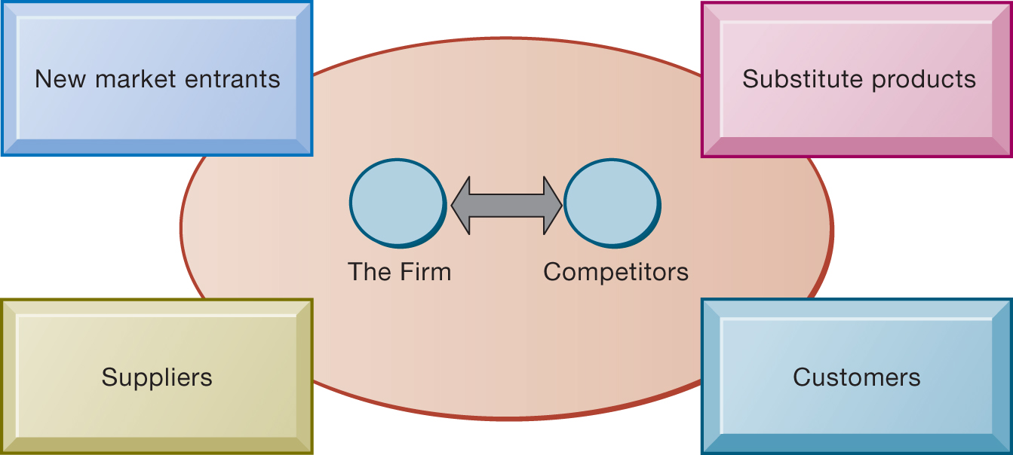
Figure 3.1 Porter’s Competitive Forces Model
Notes:
Figure 3.1, Page 81.
In Porter’s competitive forces model, the strategic position of the firm and its strategies are determined not only by competition with its traditional direct competitors but also by four forces in the industry’s environment: new market entrants, substitute products, customers, and suppliers.
A good way to teach this model is to take a specific industry and ask students to fill in the boxes in the model (starting with the environmental boxes). Any industry can be analyzed: automobiles, PC computers, smartphones, and so on.
Long Description:
The diagram illustrates “The Firm” and “Competitors” as the major elements of Porter’s competitive forces model. It shows the firm and competitors sharing a direct relationship, denoted by a double-headed arrow. The other competitive forces of the model are “New market entrants,” “Substitute products,” “Customers,” and “Suppliers.”

Slide 4
Information System Strategies for Dealing with Competitive Forces (1 of 5)
Basic strategy: Align I T with business objectives
  Identify business goals and strategies
  Break strategic goals into concrete activities and processes
  Identify metrics for measuring progress
  Determine how I T can help achieve business goals
  Measure actual performance
Notes:
Information systems often play a critical role in defining and achieving strategic objectives of the firm. Sometimes, IS is tangential: Coca Cola for instance is not an intense technology user and maintains its differentiated product through marketing and branding efforts. Other firms are intensely using IS to achieve competitive advantages, from Walmart to Facebook, Amazon, and Google.
The first step in using information systems to serve your firm is to make sure the IS objectives are lined up with the business objectives.

Slide 5
Information System Strategies for Dealing with Competitive Forces (2 of 5)
Low-cost leadership
  Use information systems to achieve the lowest operational costs and the lowest prices
  E.g. Walmart
    Inventory replenishment system sends orders to suppliers when purchase recorded at cash register
    Minimizes inventory at warehouses, operating costs
    Efficient customer response system
Notes:
In the physical retail industry, including groceries, the keys to success are efficiency in moving product through your pipeline, minimizing inventory and time delays between receipt of the goods, and the customer purchase. Large regional and national grocery chains like Krogers, Walmart, Shoprite, Safeway, and Publix are competing directly with Amazon by offering online ordering and home delivery using their local stores as warehouses.

Slide 6
Information System Strategies for Dealing with Competitive Forces (3 of 5)
Product differentiation
  Use information systems to enable new products and services, or greatly change the customer convenience in using your existing products and services
  E.g., Google's continuous innovations, Apple's i Phone
  Use information systems to customize, personalize products to fit specifications of individual consumers
    E.g., Nike's NIKE i D program for customized sneakers
Notes:
Ask students to help you make a list of companies that have really unique products or services. It's fun to ask students for local firms on this list. There may be a really unique pizza store, theater, or restaurant in the neighborhood to help illustrate the point about product differentiation as a competitive strategy.

Slide 7
Information System Strategies for Dealing with Competitive Forces (4 of 5)
Focus on market niche
  Use information systems to enable specific market focus, and serve narrow target market better than competitors.
    Analyzes customer buying habits, preferences
    Advertising pitches to smaller and smaller target markets
  E.g., Hilton Hotel’s On Q System
    Analyzes data collected on guests to determine preferences and guest's profitability
Notes:
Ask students for web stores that appeal to a very small niche market, e.g., people with unique hobbies, special interests, or different political and cultural views. Etsy is a good example to visit in class.

Slide 8
Information System Strategies for Dealing with Competitive Forces (5 of 5)
Strengthen customer and supplier intimacy.
  Strong linkages to customers and suppliers increase switching costs and loyalty
  Toyota: uses I S to facilitate direct access from suppliers to production schedules
    Permits suppliers to decide how and when to ship supplies to plants, allowing more lead time in producing goods
  Amazon: keeps track of user preferences for purchases, and recommends titles purchased by others
Notes:
Ask students to describe and discuss firms that they believe really “care about the customer” or offer great customer service. If this proves difficult, ask them to talk about companies with really poor customer service. Everybody knows a really poor customer service organization. In these discussions, ask students how IS could help improve the relationship with the customer.

Slide 9
The Internet’s Impact on Competitive Advantage
Enables new products and services
Encourages substitute products
Lowers barrier to entry
Changes balance of power of customers and suppliers
Transforms some industries
Creates new opportunities for creating new markets, building brands, and large customer bases
Smart products and the Internet of Things
Notes:
Ask students to help you put together a list of industries that have been greatly impacted by the Internet and the web. Then for each industry, ask them to describe how the Internet has changed the industry. How has the Internet changed that industry from a consumer perspective? Can students think of some industries that have been destroyed by the Internet? Or greatly changed? Record stores, video stores, and small local bookstores come to mind.

Slide 10
The Business Value Chain Model
Highlights specific activities in a business where competitive strategies can best be applied and where information systems are likely to have a strategic impact.
  Primary activities
  Support activities
  Benchmarking
  Best practices
Notes:
Porter's industry analysis is not the only competitive strategy model. In the business chain (really a business process model), firms achieve competitive advantages by being more efficient. This does not mean low-priced. The gains from efficiency may be retained by the firm as greater profits, depending on the competitive situation. For instance, Walmart adopted a business value chain model to achieve the lowest prices, but not so low as to report lower profits.

Slide 11
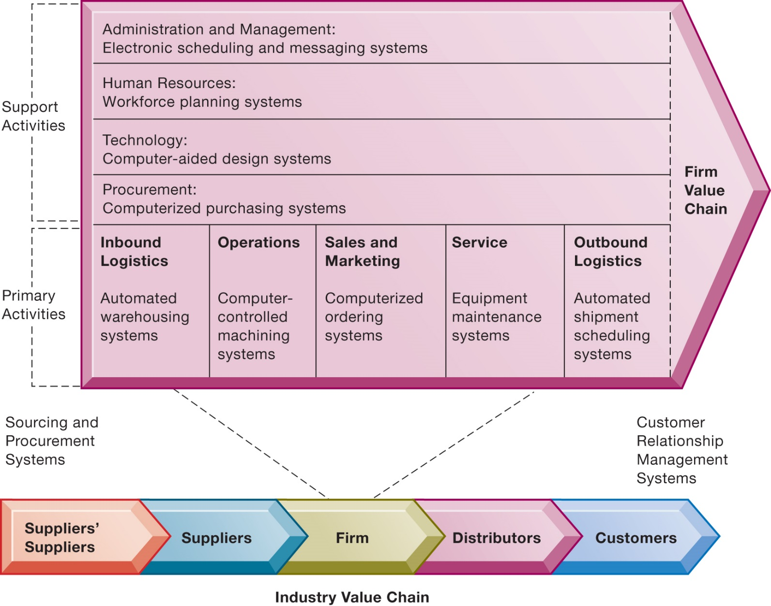
Figure 3.2 The Value Chain Model
Notes:
Figure 3.2, Page 89.
This figure provides examples of systems for both primary and support activities of a firm and of its value partners that would add a margin of value to a firm’s products or services.
You can ask a single student to describe the business value chain in a business where they now work, or did work. Then ask the student to talk about how information systems were used in each step of the value chain.
Long Description:
The diagram illustrates the firm’s activities classified as “Support activities” and “Primary activities.” The support and primary activities establish the “firm value chain.” The different support activities are as follows:
Administration and Management: Electronic scheduling and messaging systems
Human Resources: Workforce planning systems
Technology: Computer-aided design systems
Procurement: Computerized purchasing systems
The different primary activities are as follows:
Inbound Logistics: Automated warehousing systems
Operations: Computer-controlled machining systems
Sales and Marketing: Computerized ordering systems
Service: Equipment maintenance systems
Outbound Logistics: Automated shipment scheduling systems
The activities of the firm value chain result in the “Industry Value Chain” divided into five phases in a continuum in which they operate as, “Suppliers’ Suppliers,” “Suppliers,” “Firm,” “Distributors,” and “Customers.” The continuum is labeled as “Sourcing and Procurement Systems” on its left and as “Customer Relationship Management Systems” on its right.

Slide 12
The Value Chain Model
The value chain model, developed by Michael Porter, outlines how a company creates value through various activities. It helps identify the primary and support activities that contribute to a firm's competitive advantage.
This model is a useful framework for strategic planning and can help organizations optimize their operations to enhance profitability and competitiveness.

Slide 13
The Value Chain Model
Primary Activities
1.Inbound Logistics: Receiving, warehousing, and inventory management of raw materials.
2.Operations: Processes that transform inputs into final products or services.
3.Outbound Logistics: Activities required to get the finished product to customers, including storage and order fulfillment.
4.Marketing and Sales: Strategies and activities to promote and sell the product.
5.Service: Activities related to maintaining and enhancing the product's value post-sale, such as customer support.

Slide 14
The Value Chain Model
Support Activities
1.Firm Infrastructure: Organizational structure, management, planning, and control systems(It's the overall support structure needed to manage the business.).
2.Human Resource Management: Recruitment, hiring, training, and development of personnel.
3.Technology Development: Research and development, process automation, and product design.
4.Procurement: Acquiring goods and services needed for the company's operations.
Notes:
Support Activities:
assist the primary activities by providing the necessary infrastructure, resources, and services that enable the business to function effectively and efficiently.

Slide 15
The Value Chain Model
Use cases for the Value Chain Model
Identify Competitive Advantage: Analyze which activities provide the most value and differentiate the firm from competitors.
Cost Analysis: Determine where costs can be reduced without sacrificing quality.
Improve Efficiency: Streamline operations and processes for better performance.
Enhance Customer Value: Focus on activities that improve customer satisfaction and loyalty.

Slide 16
The Value Web
A firm’s value chain is linked to the value chains of its suppliers, distributors, and customers.
Value web
  Collection of independent firms that use information technology to coordinate their value chains to produce a product collectively
  Value webs are flexible and adapt to changes in supply and demand
Notes:
The phenomenon where several firms cooperate with one another in order to put together for the customer a single product or service goes by many names. At times it has been referred to as the extended firm, the virtual firm, the contract firm, and so on. To a large extent, business firms have always been dependent on their suppliers, logistics partners (trucking and railroads), and distributors including retailers. But in the Internet age, this kind of dependence and coordination takes place much more broadly and continuously. A small Internet company often works with a design firm thousands of miles away, a software firm on a different continent, and sells its products using Google's Ad Word program. The customer receives a single product or service which was co-produced by many firms working together closely.

Slide 17
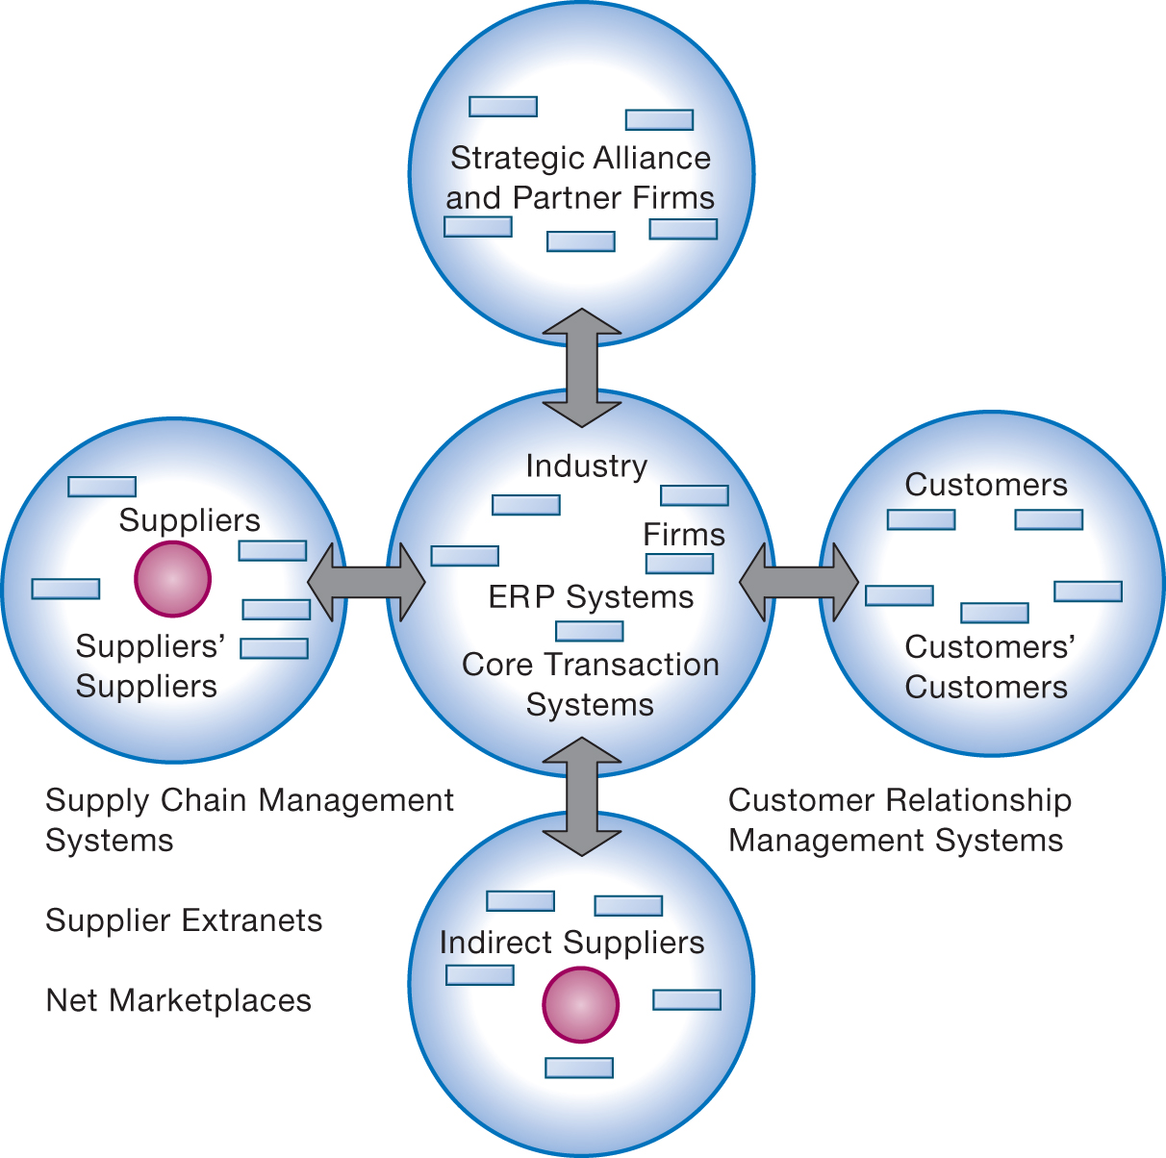
Figure 3.3 The Value Web
Notes:
Figure 3.3, Page 90.
The value web is a networked system that can synchronize the value chains of business partners within an industry to respond rapidly to changes in supply and demand.
Long Description:
The diagram illustrates the value web as a diverging radial with one circle at the center and four circles arranged around it on the top, right, bottom, and left. A double-headed arrow connects each circle with the circle at the center. The elements labeled in the center circle are “Industry,” “Firms,” “E R P Systems,” and “Core Transaction Systems.” The elements labeled in the right circle are “Customers” and “Customers’ Customers.” The element labeled in the bottom circle is “Indirect Suppliers.” The elements labeled in the left circle are “Suppliers” and “Suppliers’ Suppliers.” The circle on the right and on the bottom share a customer relationship management systems while the circle on the left and on the bottom share a supply chain management systems involving supplier extranets and net marketplaces.

Slide 18
Value chain vs value web
 | Value Chain Model | Value Web
Definition | A linear framework outlining the sequence of activities that create value within an organization. | A dynamic network of interconnected organizations, individuals, and processes that collaboratively create value.
Structure | Linear and sequential, often visualized as a chain of activities from inbound logistics to service. | Non-linear and networked, emphasizing collaboration and interdependencies among multiple stakeholders.
Focus | Internal processes and efficiencies to optimize value creation. | External collaboration, customer involvement, and adaptability to market changes.
Notes:
The value web is a more complex, interconnected model where a company’s activities are part of a broader network of collaborations and interactions with other organizations (suppliers, partners, customers, etc.)

Slide 19
Value chain vs value web
 | Value Chain Model | Value Web
Stakeholders | Primarily focused on the organization and its direct operations (suppliers, operations, etc.). | Includes a wide range of stakeholders: suppliers, partners, customers, and even competitors in collaborative networks.
Flexibility | Generally more rigid due to its sequential nature; changes require re-evaluation of the entire chain. | Highly flexible, allowing for quick adaptation to changing market conditions and new partnerships.
Technology Role | Technology supports operational efficiencies and process improvements within the chain. | Technology enables real-time communication, collaboration, and data sharing across the network.
Customer Involvement | Customers are typically considered at the end of the chain (post-sale service). | Customers are actively involved throughout the value creation process, providing feedback and insights.

Slide 20
Value chain vs value web
 | Value Chain Model | Value Web
Innovation | Focuses on improving existing processes for efficiency. | Encourages co-innovation through collaboration and shared knowledge among stakeholders.
Examples | Manufacturing processes, traditional supply chains. | Platforms like Amazon, where suppliers, distributors, and customers interact dynamically.

